Slide 1
CSSE3113 – Introduction to Software Engineering
Software Testing

Slide 2
Software Testing
The process of operating a system or component under specified conditions, observing or recording the results, and making an evaluation of some aspect of the system or component.

Slide 3
Software Testing
Testing can be defined as
“ A process of analyzing a software item to detect the differences between existing and required conditions and to evaluate the features of the software item”
According to IEEE standard

Slide 4
Software Testing
- Testing is intended to show that a program does what it is intended to do and to discover program defects before it is put into use.
- When you test software, you execute a program using artificial data. You check the results of the test run for errors, anomalies, or information about the program’s non-functional attributes.

Slide 5
Who Does Testing?
In most cases, following professionals are involved in testing of a system within their respective capacities:
Software Tester
Software Developer
Project Leader/Manager
End User

Slide 6
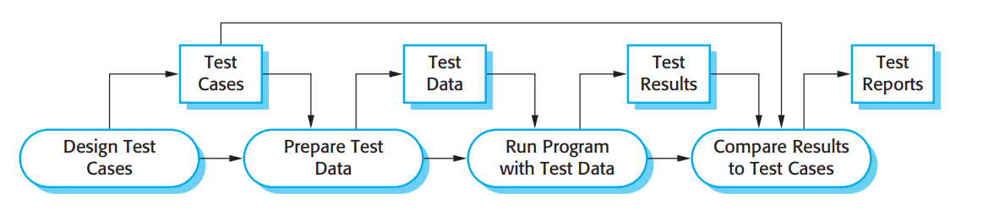
A model of the software testing process

Slide 7
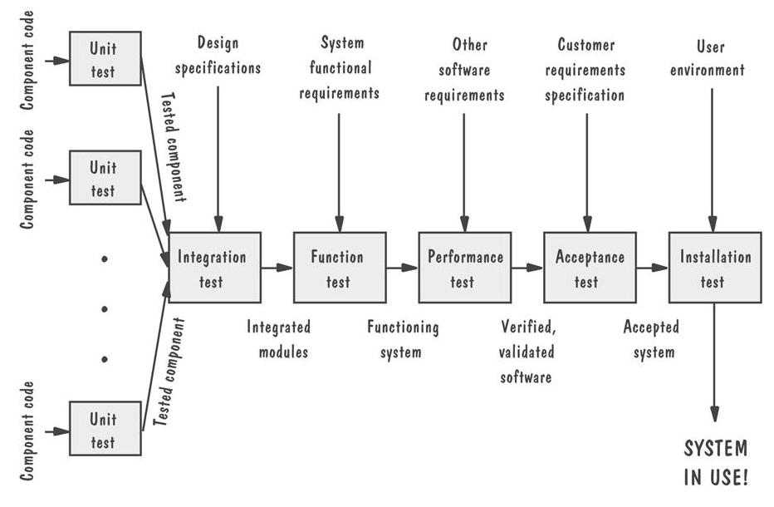
Levels of Testing Testing Organization Illustrated

Slide 8
Types of Testing
Manual testing
This type includes the testing of the Software manually i.e. without using any automated tool.
There are different stages for manual testing like unit testing, Integration testing, System testing and User Acceptance testing.
Testers use test plan, test cases or test scenarios to test the Software to ensure the completeness of testing.

Slide 9
Automation Testing
Automation testing which is also known as Test Automation, is when the tester uses another software to test the software.
This process involves automation of a manual process.
Integration of computerized tools into the process of software testing.
Code auditing
Coverage monitoring
Load tests…etc

Slide 10
Software Testing
Typically, a commercial software system has to go through three stages of testing:
Development testing, where the system is tested during development to discover bugs and defects. System designers and programmers are likely to be involved in the testing process.
Release testing, where a separate testing team tests a complete version of the
system before it is released to users. The aim of release testing is to check that
the system meets the requirements of system stakeholders.
User testing, where users or potential users of a system test the system in their
own environment.
For software products, the ‘user’ may be an internal marketing group who decide if the software can be marketed, released, and sold. Acceptance testing is one type of user testing.

Slide 11
Classification According to Testing Concept
Black Box Testing
White Box Testing
Gray Box Testing

Slide 12
Black Box Testing
The technique of testing without having any knowledge of the interior workings of the application is Black Box testing.
The tester does not have access to the source code.
A tester will interact with the system's user interface by providing inputs and examining outputs without knowing how and where the inputs are worked upon.

Slide 13
Black Box Testing
Advantages
Well suited and efficient for large code segments.
Code Access not required.
Clearly separates user's perspective from the developer's perspective.
Large numbers of moderately skilled testers can test the application with no knowledge of implementation, programming language or operating systems.

Slide 14
Black Box Testing
Disadvantages
Inefficient testing, due to the fact that the tester only has limited knowledge about an application.
Blind Coverage, since the tester cannot target specific code segments or error prone areas.
The test cases are difficult to design.

Slide 15
White Box Testing
White box testing is the detailed investigation of internal logic and structure of the code.
White box testing is also called glass testing or open box testing.
In order to perform white box testing on an application, the tester needs to have knowledge of the internal working of the code.
The tester needs to have a look inside the source code and find out which unit/chunk of the code is behaving inappropriately.

Slide 16
White Box Testing
Advantages
As the tester has knowledge of the source code, it becomes very easy to find out which type of data can help in testing the application effectively.
Extra lines of code can be removed which can bring in hidden defects.
Due to the tester's knowledge about the code, maximum coverage is attained during test scenario writing.

Slide 17
White Box Testing
Disadvantages
Due to the fact that a skilled tester is needed to perform white box testing, the costs are increased.
Sometimes it is impossible to look into every nook and corner to find out hidden errors.
It is difficult to maintain white box testing as the use of specialized tools like code analyzers and debugging tools are required.

Slide 18
Black Box vs White Box
Black Box Testing | White Box Testing
The Internal Workings of an application are not required to be known | Tester has full knowledge of the Internal workings of the application
Also known as closed box testing, data driven testing and functional testing | Also known as clear box testing, structural testing or code based testing
Performed by end users and also by testers and developers | Normally done by testers and developers
Testing is based on external expectations - Internal behavior of the application is unknown | Internal workings are fully known and the tester can design test data accordingly
This is the least time consuming and exhaustive | The most exhaustive and time consuming type of testing
Not suited to algorithm testing | Suited for algorithm testing

Slide 19
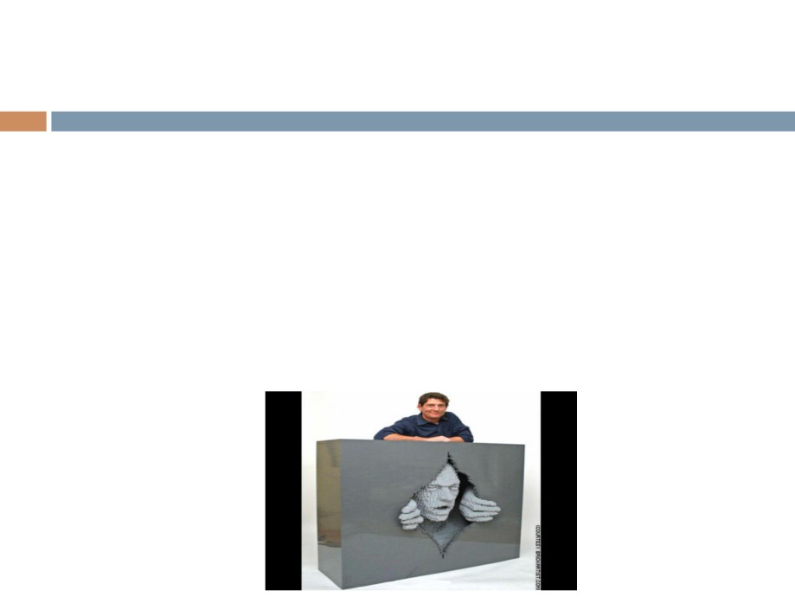
Gray Box Testing
Gray box testing is a software testing technique that uses a combination of black box testing and white box testing. Gray box testing is not black box testing, because the tester does
know some of the internal workings of the software under test.
In gray box testing, the tester applies a limited number of test cases to the internal workings of the software under test. In the remaining part of the gray box testing, one takes a black box approach in applying inputs to the software under test and observing the outputs.
This is particularly important when conducting integration testing between two modules of code written by two different developers, where only the interfaces are exposed for test.

Slide 20
Testing strategies/ Development testing
There are basically two testing strategies:
Big bang testing: tests the software as a whole, once the completed package is available.
Incremental testing:
Tests the software piecemeal – software modules are tested as they are completed (unit tests)
followed by groups of modules composed of tested modules integrated with newly completed modules (integration tests).
Once the entire package is completed, it is tested as a whole (system test).

Slide 21
Unit Testing
Unit testing is performed by the respective developers on the individual units of source code assigned areas.
The goal of unit testing is to isolate each part of the program and show that individual parts are correct in terms of requirements and functionality.

Slide 22
Integration Testing /System testing
The testing of combined parts of an application to determine if they function correctly together is Integration testing.
System Testing
This is the next level in the testing and tests the system as a whole.
Once all the components are integrated, the application as a whole is tested to see that it meets Quality Standards.
This type of testing is performed by a specialized testing team.

Slide 23
Regression Testing
Whenever a change in a software application is made it is quite possible that other areas within the application have been affected by this change.
The intent of Regression testing is to ensure that a change, such as a bug fix did not result in another fault being uncovered in the application.

Slide 24
User Testing
In practice, there are three different types of user testing:
Alpha testing, where users of the software work with the development team to test the software at the developer’s site.
Beta testing, where a release of the software is made available to users to allow them to experiment and to raise problems that they discover with the system developers.
Acceptance testing, where customers test a system to decide whether or not it is ready to be accepted from the system developers and deployed in the customer environment.

Slide 25
Whitebox Testing Control Flow Graph
Cyclomatic Complexity is defined as:
CC=E−N+2P Where:
E = Number of edges (transitions or connections between nodes in the flow graph)
N = Number of nodes (decision points or statements in the flow graph)
P = Number of connected components or exits (typically P=1 for a single program)
Cyclomatic Complexity = E – N + 2 = 9 – 9 + 2 = 2

Slide 26
Whitebox Testing graph (Adjacency) matrices
Connected to Node
a
b
 | 2 | 3 | 4 | 5 | 6 | 7 | 8 | 9 | 10
2 |  | a
3 |  |  | b
4 |  |  |  | c
5 |  |  |  |  | d | e
6 |  |  |  |  |  |  | f
7 |  |  |  |  |  |  | g
8 |  |  |  |  |  |  |  | h
9 |  |  |  |  |  |  |  |  | i
10
c
d
e
f
g
Node
h
i
Control Flow Graph
Graph Matrix
To this point, the graph matrix is nothing more than a tabular representation of a flow graph.

Slide 27
Whitebox Testing graph (Adjacency) matrices
By adding a link weight to each matrix entry, the graph matrix can become a powerful tool for evaluating program control structure during testing. The link weight provides additional information about control flow. In its simplest form, the link weight is 1 (a connection exists) or 0 (a connection does not exist). Following are the steps to compute the cyclomatic complexity in Graph Matrices : Count the number of 1s in each row and write it in the end of the row Subtract 1 from this count for each row (ignore the row if its count is 0) Add the count of each row calculated previously Add 1 to this total count The final sum in Step 4 is the cyclomatic complexity of the control flow graph
https://www.geeksforgeeks.org/graph-matrices-in-software-testing/

Slide 28
Whitebox Testing graph (Adjacency) matrices
Connected to Node
 | 2 | 3 | 4 | 5 | 6 | 7 | 8 | 9 | 10
2 |  | 1 |  |  |  |  |  |  |  | 1-1 | 0
3 |  |  | 1 |  |  |  |  |  |  | 1-1 | 0
4 |  |  |  | 1 |  |  |  |  |  | 1-1 | 0
5 |  |  |  |  | 1 | 1 |  |  |  | 2-1 | 1
6 |  |  |  |  |  |  | 1 |  |  | 1-1 | 0
7 |  |  |  |  |  |  | 1 |  |  | 1-1 | 0
8 |  |  |  |  |  |  |  | 1 |  | 1-1 | 0
9 |  |  |  |  |  |  |  |  | 1 | 1-1 | 0
10
Node
Cyclomatic Complexity
(Control Flow graph)
= E – N + 2
= 9 – 9 + 2
= 2
Sum of column =1
Cyclomatic Complexity = 1+1=2
(Graph Matrix)

Slide 29
Cyclomatic Complexity
Cyclomatic Complexity | Meaning
1 – 10 | Structured and Well Written Code High Testability Less Cost and Effort
10 – 20 | Complex Code Medium Testability Medium Cost and Effort
20 – 40 | Very Complex Code Low Testability High Cost and Effort
> 40 | Highly Complex Code Not at all Testable Very High Cost and Effort
https://www.gatevidyalay.com/cyclomatic-complexity-calculation-examples/

Slide 30
Rules
We will not compute CC for whole project but for per function or per method.
Compute CC for each function separately.
In CC=E-N+2P:
P is number of connected components (normally 1 per function)

Slide 31
Example
int max(int a, int b) {
if (a > b)
return a;
else
return b;
}
E=5
N=5
P=1
CC=5-5+2(1)=>2
1
2
3
5
6

Slide 32
Example with loop +condition
void fun(int x) {
while (x > 0) {
if (x % 2 == 0)
x--;
else
x = x - 2;
}
}
E=7
N=6
P=1
CC=7-6+2(1)=>3
1
2
3
4
6
8

Slide 33
Code Example with Multiple Independent Functions
void funcA(int x) {
while (x > 0) {
if (x % 2 == 0)
x--;
else
x = x - 3;
}
}
void funcB(int y) {
for (int i = 0; i < y; i++) {
if (i == 5)
break;
}
}
funcA and funcB are independent
No function calls between them
When combined into one flow graph, they form two disconnected components
So P=2 not 1

Slide 34
Code Example with Multiple Independent Functions
E=7 N=6
E=6 N=5
1
9
2
10
11
3
8
12
4
6
14

Slide 35
Code Example with Multiple Independent Functions
So E=7+6=13
N=6+5=11
P=2
CC=13-11+2(2)
=2+4
=6

Slide 36
In a class
class Account {
int balance;
boolean isPositive() {
if (balance > 0)
return true;
return false;
}
}
Nodes:
Start
if (balance > 0) → decision node
return true
return false
End
CC = E − N + 2P = 5 − 5 + 2
=2

Slide 37
In a class
class Demo {
void A(int x) {
if (x > 0)
x++;
}
void B(int y) {
for (int i = 0; i < y; i++) {
if (i == 5)
break;
}
}
}
A and B will be treated independently as we discussed previously and P=2

Slide 38
Nested functions
def outer(x):
if x > 0:
def inner(y):
while y > 0:
y -= 1
inner(x)
else:
print("x is non-positive")
P=2 why?
1-2
2-6(if true)
2-8(if false)
6-end of outer
8-end of outer
E=5 N=5
Now other fun
3-4
4-5(if true)
5-4 (for loop)
4-end of inner
E=4 N=4
CC=9-9+4=4

Slide 39
In exception handling
try itself does not create a separate node, unless it contains executable statements.
catch counts as a decision point / separate node because it introduces an alternative control flow.
finally, is usually treated as a normal node since it always executes.
void process() {
try {
action1();
} catch(Exception e) {
action2();
} finally {
cleanup();
}
}
Node | Meaning
1 | Start
2 | action1() in try
3 | catch block → action2()
4 | finally → cleanup()
5 | End
1-2
2-3(if any issue)
2-4(in any case will execute)
3-4
4-5
E = 5, N = 5, P = 1

Slide 40
If any recursive function call
def factorial(n):
if n <= 1:
return 1
else:
return n * factorial(n-1)
loop executes multiple times in the same activation
Each recursive call is a new activation, not part of the current function’s control flow and CFG models one function activation. So no edge between 4 and 1 like loops
Node | Meaning
1 | Start
2 | If true
3 | return
4 | Recursive call
5 | End
1-2
2-3(if ture)
2-4
3-5
4-5
E = 5, N = 5, P = 1

Slide 41
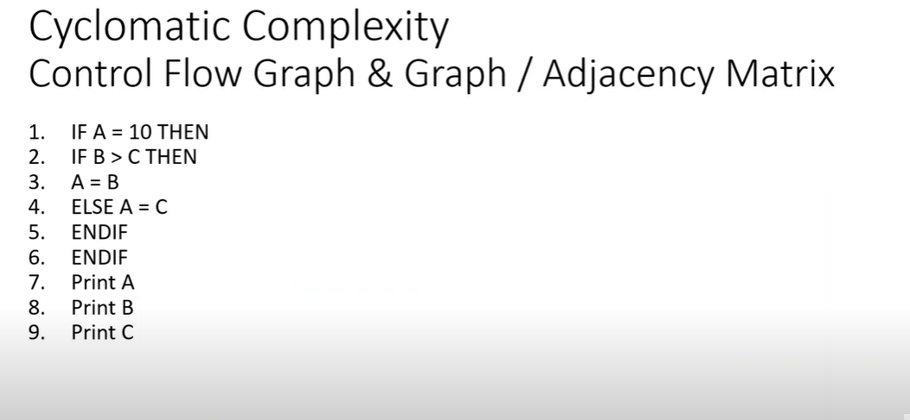
Practice

